Slide 1
MGM’s College of Engineering & Technology, Kamothe. Department of Computer Engineering Subject: Python Programming (CSL405) Second Year – Semester IV A.Y. – 2021-22
Subject In-Charge: Prof. Anand A. Ingle

Slide 2
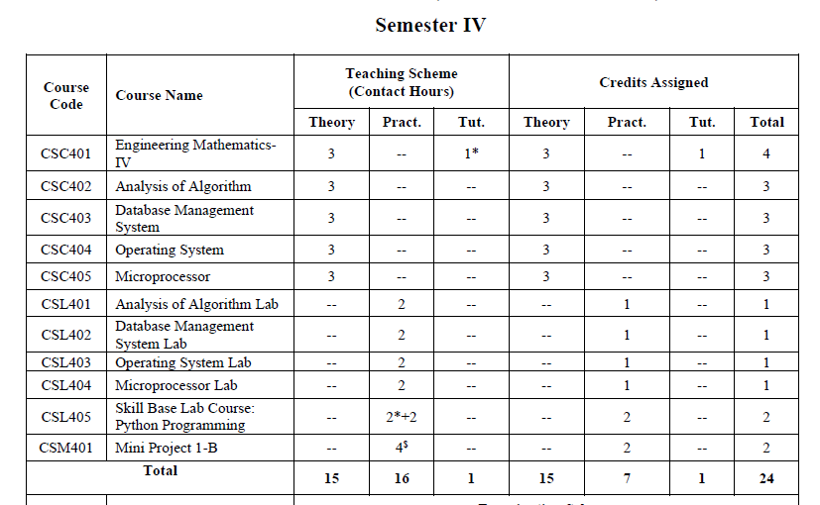

Slide 3
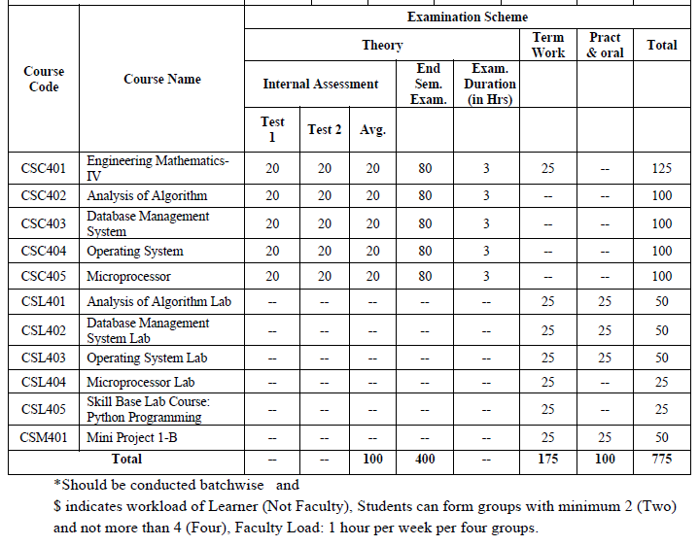

Slide 4
Introduction to Python
Python is a general purpose high level programming language.
Python was developed by Guido Van Rossum in 1989 while working at National Research Institute at Netherland. But officially Python was made available to public in 1991.
The official Date of Birth for Python is : Feb 20th 1991.
Python is recommended as first programming language for beginners.

Slide 5
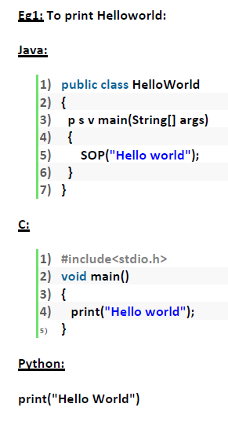

Slide 6
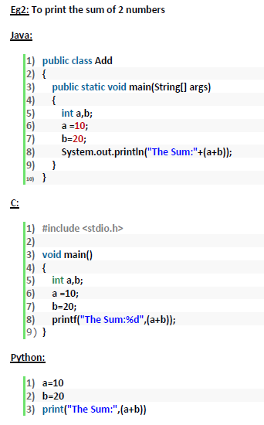

Slide 7
History of Python
The name Python was selected from the TV Show "The Complete Monty Python's Circus", which was broadcasted in BBC from 1969 to 1974.
Guido developed Python language by taking almost all programming features from different languages
1. Functional Programming Features from C
2. Object Oriented Programming Features from C++
3. Scripting Language Features from Perl and Shell Script
4. Modular Programming Features from Modula-3
Most of syntax in Python Derived from C and ABC languages.

Slide 8
Applications of Python
1. For developing Desktop Applications
2. For developing web Applications
3. For developing database Applications
4. For Network Programming
5. For developing games
6. For Data Analysis Applications
7. For Machine Learning
8. For developing Artificial Intelligence Applications
9. For IOT
Note:
* Internally Google and Youtube use Python coding
* NASA and New York Stock Exchange Applications developed by Python.
* Top Software companies like Google, Microsoft, IBM, Yahoo using Python.

Slide 9
Features of Python
1. Simple and easy to learn:
Python is a simple programming language. When we read Python program, we can feel like reading english statements.
The syntaxes are very simple and only 30+ keywords are available.
When compared with other languages, we can write programs with very less number of lines. Hence more readability and simplicity.
We can reduce development and cost of the project.
2. Freeware and Open Source:
We can use Python software without any license and it is freeware.
Its source code is open, so that we can customize based on our requirement.
Eg: Jython is customized version of Python to work with Java Applications.

Slide 10
3. High Level Programming language:
Python is high level programming language and hence it is programmer friendly language.
Being a programmer we are not required to concentrate low level activities like memory management and security etc.
4. Platform Independent:
Once we write a Python program, it can run on any platform without rewriting again.
Internally PVM is responsible to convert into machine understandable form.
5. Portability:
Python programs are portable. i.e. we can migrate from one platform to another platform very easily. Python programs will provide same results on any platform.

Slide 11
6. Dynamically Typed:
In Python we are not required to declare type for variables. Whenever we are assigning the value, based on value, type will be allocated automatically.
Hence Python is considered as dynamically typed language. But Java, C etc are Statically Typed Languages because we have to provide type at the beginning only.
This dynamic typing nature will provide more flexibility to the programmer.
7. Both Procedure Oriented and Object Oriented:
Python language supports both Procedure oriented (like C, pascal etc) and object oriented (like C++,Java) features. Hence we can get benefits of both like security and reusability etc
8. Interpreted:
We are not required to compile Python programs explicitly. Internally Python interpreter will take care that compilation.
If compilation fails interpreter raised syntax errors. Once compilation success then PVM (Python Virtual Machine) is responsible to execute.

Slide 12
9. Extensible:
We can use other language programs in Python.
1. We can use already existing legacy non-Python code
2. We can improve performance of the application
10. Embedded:
We can use Python programs in any other language programs. i.e. we can embed Python programs anywhere.
11. Extensive Library:
Python has a rich inbuilt library. Being a programmer we can use this library directly and we are not responsible to implement the functionality.
Limitations of Python:
1. Performance wise not up to the mark because it is interpreted language.
2. Not using for mobile Applications

Slide 13
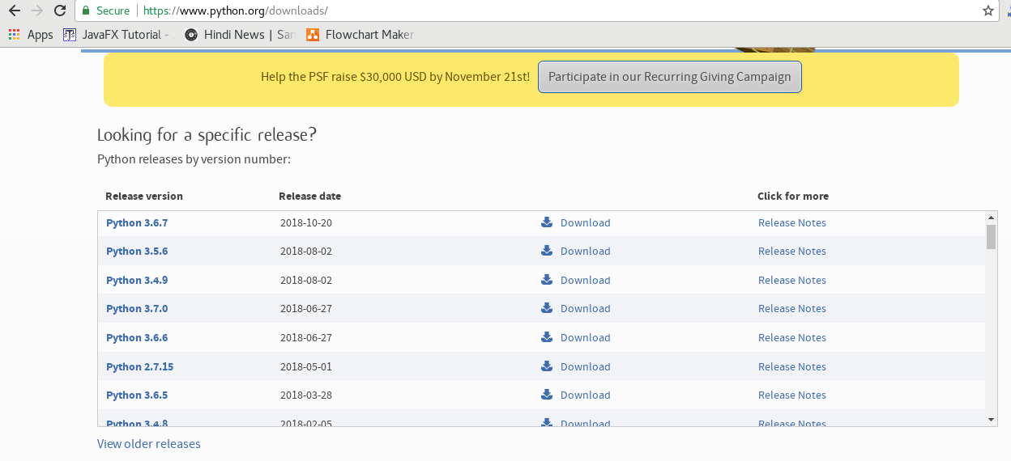
Python Installation
How to Install Python on Windows (Environment Set-up)
1. Visit the linkhttps://www.python.org/downloads/ to download the latest release of Python.

Slide 14
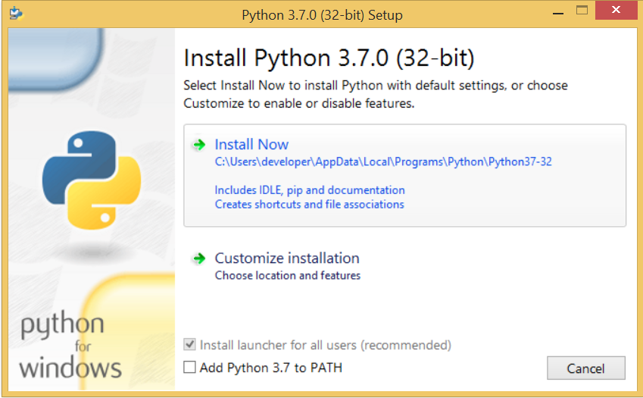
2. Double-click the executable file, which is downloaded; the following window will open. Select Customize installation and proceed.

Slide 15
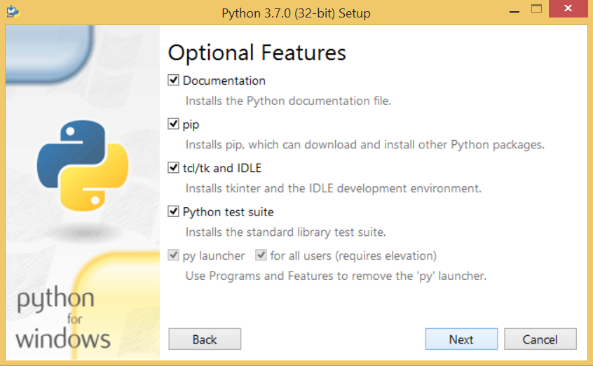
3. The following window shows all the optional features. All the features need to be installed and are checked by default; we need to click next to continue.

Slide 16
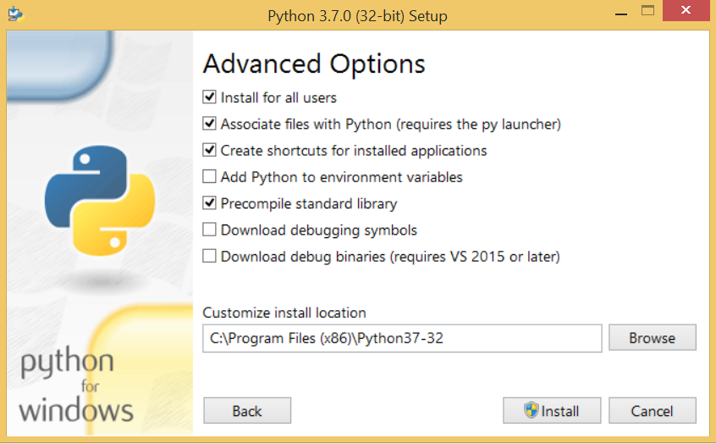
4. The following window shows a list of advanced options. Check all the options which you want to install and click next. Here, we must notice that the first check-box (install for all users) must be checked.

Slide 17
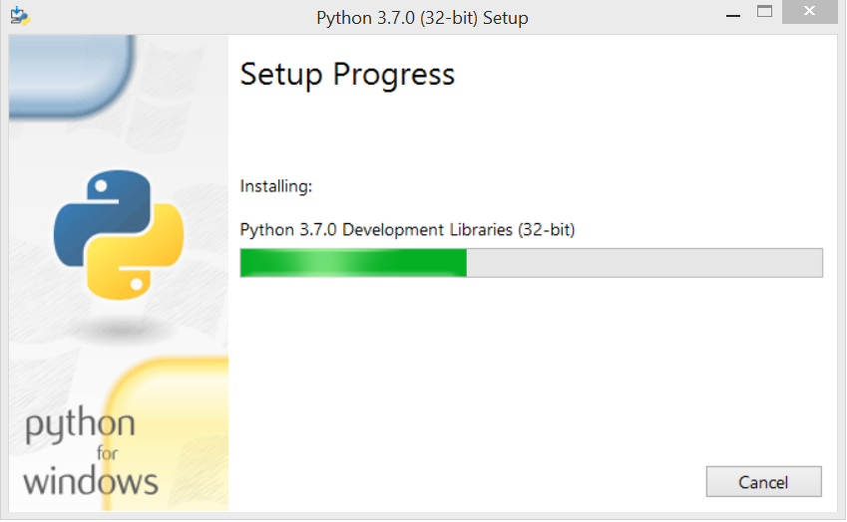
5. Now, we are ready to install python-3.6.7. Let's install it.

Slide 18
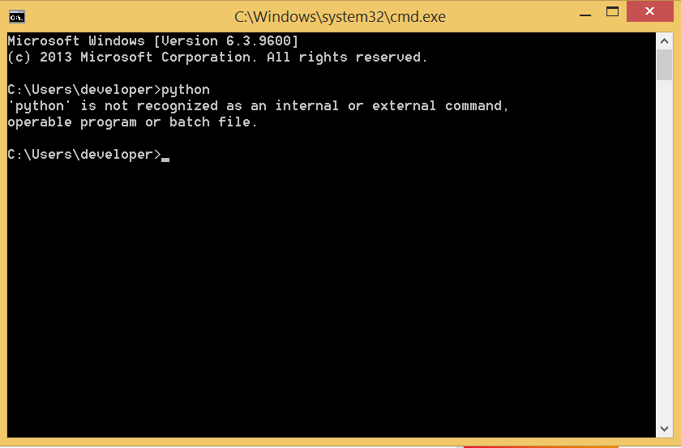
6. Now, try to run python on the command prompt. (press window button + R) Type the command python in case of python2 or python3 in case of python3. It will show an error as given in the below image. It is because we haven't set the path.

Slide 19
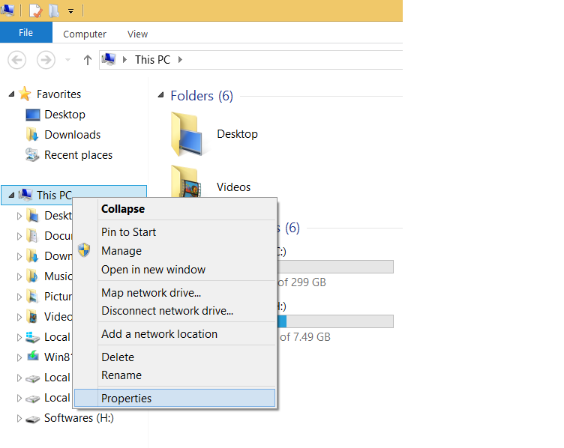
7. To set the path of python, we need to the right click on "my computer / This PC" and go to Properties → Advanced → Environment Variables.

Slide 20
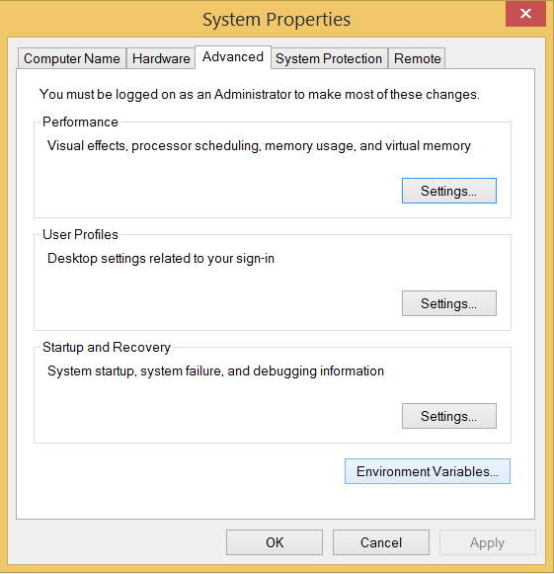

Slide 21
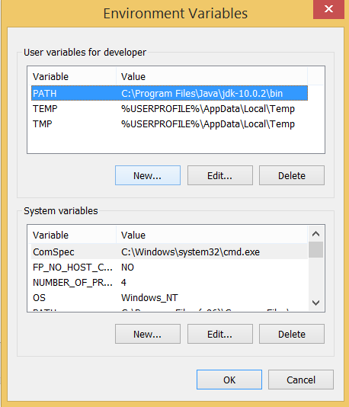
8. Add the new path variable in the user variable section.

Slide 22
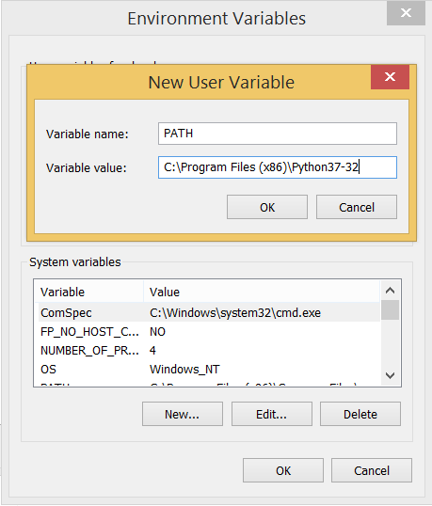
9. Type PATH as the variable name and set the path to the installation directory of the python shown in the below image.
Now, the path is set; we are ready to run python on our local system. Restart CMD, and type python again. It will open the python interpreter shell where we can execute the python statements.

Slide 23
Data Types in Python
Data Type represent the type of data present inside a variable.
In Python we are not required to specify the type explicitly. Based on value provided,
The type will be assigned automatically. Hence Python is Dynamically Typed Language.
Python contains the following inbuilt data types

Slide 24
Python inbuilt data types.
1. int
2. float
3.complex
4.bool
5.str
6.bytes
7.bytearray
8.range
9.list
10.tuple
11.set
12.frozenset
13.dict
14.None

Slide 25
Python provides various standard data types that define the storage method on each of them. The data types defined in Python are given below.
Numbers
Sequence Type
Boolean
Set
Dictionary

Slide 26
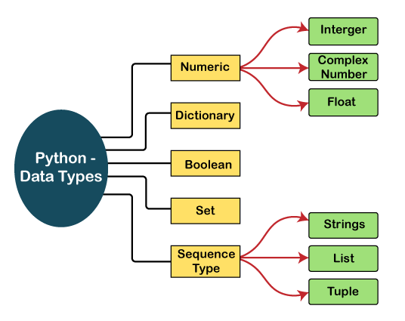

Slide 27
Python contains several inbuilt functions
1.type()
- to check the type of variable
2. id()
- to get address of object
3. print()
- to print the value
In Python everything is object

Slide 28
1. int data type
We can use int data type to represent whole numbers (integral values)
Eg: a=10
type(a) #int
Note:
In Python2 we have long data type to represent very large integral values.
But in Python3 there is no long type explicitly and we can represent long values also by using int type only.
We can represent int values in the following ways
1. Decimal form
2. Binary form
3. Octal form
4. Hexa decimal form

Slide 29
Base Conversions
Python provide the following in-built functions for base conversions
1.bin():
We can use bin() to convert from any base to binary
Ex. >>> bin(15)
'0b1111‘
2. oct():
We can use oct() to convert from any base to octal
Ex. >>> oct(10)
'0o12‘
3. hex():
We can use hex() to convert from any base to hexa decimal
Ex: >>> hex(100)
'0x64'

Slide 30
2. float data type:
We can use float data type to represent floating point values (decimal values)
Ex: f=1.234
type(f) float
We can also represent floating point values by using exponential form (scientific notation)
Ex: f=1.2e3
print(f) 1200.0
instead of 'e' we can use 'E'
The main advantage of exponential form is we can represent big values in less memory.

Slide 31
3. bool data type:
We can use this data type to represent boolean values.
The only allowed values for this data type are:
True and False
Internally Python represents True as 1 and False as 0
Ex: b=True
type(b) =>bool
Ex:
a=10
b=20
c=a<b
print(c)==>True

Slide 32
4. str type:
str represents String data type.
A String is a sequence of characters enclosed within single quotes or double quotes.
Ex: s1=‘India'
s1=“India"
By using single quotes or double quotes we cannot represent multi line string literals.
s1=“India
is great"
For this requirement we should go for triple single quotes(''') or triple double quotes(""")
Ex: s1=‘’’ India
is great''‘ OR
s1=""“ India
is great """

Slide 33
We can also use triple quotes to use single quote or double quote in our String.
''' This is " character'''
' This is " Character '
We can embed one string in another string
'''This "Python class very helpful" for students''‘
Slicing of Strings:
slice means a piece
[ ] operator is called slice operator, which can be used to retrieve parts of String.
In Python Strings follows zero based index.
The index can be either +ve or -ve.
+ve index means forward direction from Left to Right
-ve index means backward direction from Right to Left

Slide 34
Example:
#Using single quotes
str1 = 'Hello Python'
print(str1)
#Using double quotes
str2 = "Hello Python"
print(str2)
#Using triple quotes
str3 = '''Triple quotes are generally used for
represent the multiline or
docstring'''
print(str3)

Slide 35
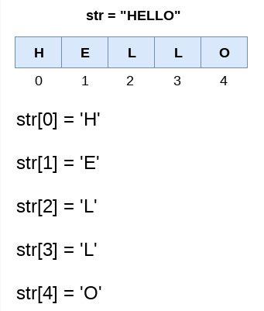
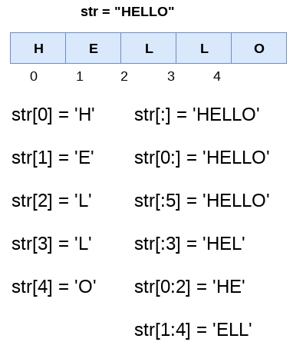

Slide 36
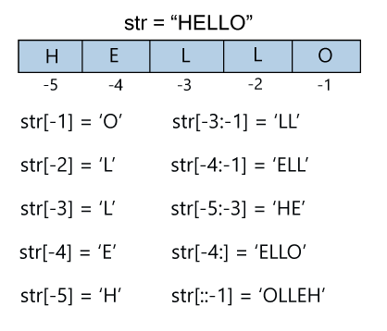

Slide 37
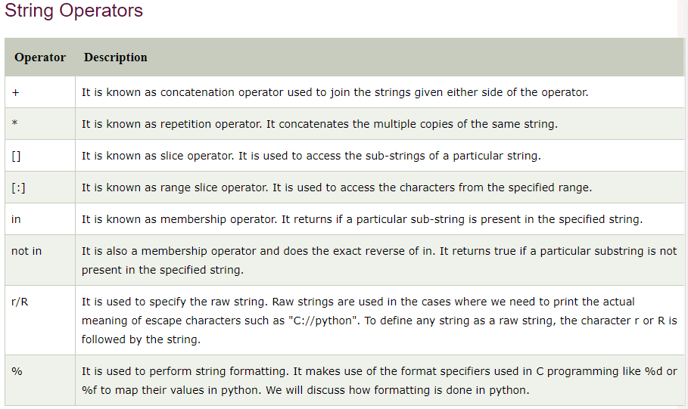

Slide 38
5. bytes Data Type:
bytes data type represents a group of byte numbers just like an array.
Ex:
x = [10,20,30,40]
b = bytes(x)
type(b)==>bytes
print(b[0])==> 10
print(b[-1])==> 40
>>> for i in b : print(i)
10
20
30
40
Conclusion 1:
The only allowed values for byte data type are 0 to 256. By mistake if we are trying to provide any other values then we will get value error.
Conclusion 2:
Once we creates bytes data type value, we cannot change its values, otherwise we will get TypeError.

Slide 39
6. bytearray Data type:
bytearray is exactly same as bytes data type except that its elements can be modified.
Ex. 1: x=[10,20,30,40]
b = bytearray(x)
for i in b : print(i)
10
20
30
40
b[0]=100
for i in b: print(i)
100
20
30
40
Ex. 2:
>>> x =[10,256]
>>> b = bytearray(x)
ValueError: byte must be in range(0, 256)

Slide 40
7. Complex data type
A complex number contains an ordered pair, i.e., x + jy, where x and y denote the real and imaginary parts, respectively.
The complex numbers like 2.14j, 2.0 + 2.3j, etc.
Ex: a=10+1.5j
b=20+2.5j
c=a+b
print(c) #(30+4j)
type(c) # <class 'complex'>

Slide 41
Note: Complex data type has some inbuilt attributes to retrieve the real part and imaginary part
c=10.5+3.6j
c.real==>10.5
c.imag==>3.6
We can use complex type generally in scientific Applications and electrical engineering applications.

Slide 42
8. list data type:
If we want to represent a group of values as a single entity where insertion order required to preserve and duplicates are allowed then we should go for list data type.
1. insertion order is preserved
2. heterogeneous objects are allowed
3. duplicates are allowed
4. Growable in nature
5. values should be enclosed within square brackets.
Ex: list=[10,10.5,’abhi',True,10]
print(list) # [10,10.5,’abhi',True,10]

Slide 43
Ex:
list=[10,20,30,40]
>>> list[0]
10
>>> list[-1]
40
>>> list[1:3]
[20, 30]
>>> list[0]=100
>>> for i in list:print(i)
...
100
20
30
40
list is growable in nature. i.e based on our requirement we can increase or decrease the size.

Slide 44
>>> list=[10,20,30]
>>> list.append(“hello")
>>> list
[10, 20, 30, ’hello']
>>> list.remove(20)
>>> list
[10, 30, ‘hello']
>>> list2=list*2
>>> list2
[10, 30, ‘hello', 10, 30, ‘hello']
Note: An ordered, mutable, heterogeneous collection of elements is nothing but list, where duplicates also allowed.

Slide 45
9. tuple data type:
tuple data type is exactly same as list data type except that it is immutable .i.e we cannot change values.
Tuple elements can be represented within parenthesis.
Ex: t=(10,20,30,40)
type(t) # <class 'tuple'>
>>>t[0]=100 #TypeError: 'tuple' object does not support item assignment
>>> t.append(“abhi") #AttributeError: 'tuple' object has no attribute 'append'
>>> t.remove(10) #AttributeError: 'tuple' object has no attribute 'remove'
Note: tuple is the read only version of list

Slide 46
10. range Data Type:
range Data Type represents a sequence of numbers.
The elements present in range Data type are not modifiable. i.e range Data type is immutable.
Form-1: range(10)
generate numbers from 0 to 9
Ex: r=range(10)
for i in r : print(i) # 0 to 9
Form-2: range(10,20) # generate numbers from 10 to 19
r = range(10,20)
for i in r : print(i) #10 to 19
Form-3: range(10,20,2) #2 means increment value
r = range(10,20,2)
for i in r : print(i) #10,12,14,16,18

Slide 47
We can access elements present in the range Data Type by using index.
r=range(10,20)
r[0]==>10
r[15]==>IndexError: range object index out of range
We cannot modify the values of range data type
Ex: r[0]=100
TypeError: 'range' object does not support item assignment
We can create a list of values with range data type
Ex:
>>> l = list(range(10))
>>> l
[0, 1, 2, 3, 4, 5, 6, 7, 8, 9]

Slide 48
11. set Data Type:
If we want to represent a group of values without duplicates where order is not important then we should go for set Data Type.
1. insertion order is not preserved
2. duplicates are not allowed
3. heterogeneous objects are allowed
4. index concept is not applicable
5. It is mutable collection
6. Growable in nature
Ex: s={100,0,10,200,10,‘hello'}
s # {0, 100, ‘hello', 200, 10}
s[0] ==>TypeError: 'set' object does not support indexing
#set is growable in nature, based on our requirement we can increase or decrease the size.
>>> s.add(60)
>>> s
{0, 100, ‘hello', 200, 10, 60}
>>> s.remove(100)
>>> s
{0, ‘hello', 200, 10, 60}

Slide 49
12. frozenset Data Type:
It is exactly same as set except that it is immutable.
Hence we cannot use add or remove functions.
13. dict Data Type:
If we want to represent a group of values as key-value pairs then we should go for dict data type.
Ex:
d={101:‘abhi',102:'ravi',103:'shiva'}
Duplicate keys are not allowed but values can be duplicated. If we are trying to insert an entry with duplicate key then old value will be replaced with new value.

Slide 50
Ex:
>>> d={101:’abhi',102:'ravi',103:'shiva'}
>>> d[101]=‘abhijit‘
>>> d
{101: ‘abhijit', 102: 'ravi', 103: 'shiva'}
# We can create empty dictionary as follows
d={ }
# We can add key-value pairs as follows
d['a']='apple‘
d['b']='banana‘
print(d) # {‘a’ : ’apple’ , ‘b’ : ‘banana’}
Note: dict is mutable and the order wont be preserved.

Slide 51
Note:
1. In general we can use bytes and bytearray data types to represent binary information like images, video files etc
2. In Python2 long data type is available. But in Python3 it is not available and we can represent long values also by using int type only.
3. In Python there is no char data type. Hence we can represent char values also by using str type.

Slide 52
Fundamental Data Types vs Immutability:
All Fundamental Data types are immutable. i.e. once we creates an object, we cannot perform any changes in that object. If we are trying to change then with those changes a new object will be created. This non-changeable behavior is called immutability.
In Python if a new object is required, then PVM wont create object immediately. First it will check is any object available with the required content or not. If available then existing object will be reused. If it is not available then only a new object will be created.
The advantage of this approach is memory utilization and performance will be improved.
But the problem in this approach is, several references pointing to the same object by using one reference if we are allowed to change the content in the existing object then the remaining references will be effected. To prevent this immutability concept is required.
According to this once creates an object we are not allowed to change content. If we are trying to change with those changes a new object will be created.

Slide 53
Operators in Python
Operator is a symbol that performs certain operations.
Python provides the following set of operators
1. Arithmetic Operators
2. Relational Operators or Comparison Operators
3. Logical operators
4. Bitwise operators
5. Assignment operators
6. Special operators

Slide 54
1. Arithmetic Operators:
+ ==>Addition
- ==>Subtraction
* ==>Multiplication
/ ==>Division operator
% ===>Modulo operator
// ==>Floor Division operator
** ==>Exponent operator or power operator

Slide 55
Ex: test.py
Code:
a=10
b=2
print('a+b=',a+b)
print('a-b=',a-b)
print('a*b=',a*b)
print('a/b=',a/b)
print('a//b=',a//b)
print('a%b=',a%b)
print('a**b=',a**b)
Output: ?

Slide 56
Output: Python test.py or py test.py
a+b= 12
a-b= 8
a*b= 20
a/b= 5.0
a//b= 5
a%b= 0
a**b= 100
Note: / operator always performs floating point arithmetic. Hence it will always returns float value.
But Floor division (//) can perform both floating point and integral arithmetic. If arguments are int type then result is int type.
If atleast one argument is float type then result is float type.

Slide 57
Note:
We can use +,* operators for str type also.
If we want to use + operator for str type then compulsory both arguments should be str type only otherwise we will get error.
>>> “abhi"+10
TypeError: must be str, not int
>>> “abhi"+"10"
‘abhi10‘
If we use * operator for str type then compulsory one argument should be int and other argument should be str type.
2*”abhi"
“abhi"*2
2.5*”abhi“ # TypeError: can't multiply sequence by non-int of type 'float'
“abhi"*”abhi“ # TypeError: can't multiply sequence by non-int of type 'str'
+====>String concatenation operator
* ===>String multiplication operator
Note: For any number x,
x/0 and x%0 always raises "ZeroDivisionError"

Slide 58
Relational Operators:
>, >=, <, <=
Ex:
a=10
b=20
print("a > b is ",a>b)
print("a >= b is ",a>=b)
print("a < b is ",a<b)
print("a <= b is ",a<=b)
Output: a > b is False
a >= b is False
a < b is True
a <= b is True
We can apply relational operators for str types also

Slide 59
Ex:
a=“abhi"
b=“abhi“
print("a > b is ",a>b)
print("a >= b is ",a>=b)
print("a < b is ",a<b)
print("a <= b is ",a<=b)
Output:
a > b is False
a >= b is True
a < b is False
a <= b is True

Slide 60
equality operators: == , !=
We can apply these operators for any type even for incompatible types also
>>> 10==20
False
>>> 10!= 20
True
>>> 10==True
False
>>> False==False
True
>>> “abhi"==“abhi“
True
>>> 10==“abhi“
False

Slide 61
Logical Operators:
and, or ,not we can apply for all types.
For boolean types behaviour:
and ==>If both arguments are True then only result is True
or ====>If atleast one arugemnt is True then result is True
not ==>complement
True and False ==>False
True or False ===>True
not False ==>True
For non-boolean types behaviour:
0 means False
non-zero means True
empty string is always treated as False

Slide 62
Bitwise Operators: &,|,^,~,<<,>>
These operators are applicable only for int and boolean types.
By mistake if we are trying to apply for any other type then we will get Error.
print(4&5) ==>valid
print(10.5 & 5.6) ==> TypeError: unsupported operand type(s) for &: 'float' and 'float'
print(True & True) ==>valid
& ==> If both bits are 1 then only result is 1 otherwise result is 0
| ==> If atleast one bit is 1 then result is 1 otherwise result is 0
^ ==>If bits are different then only result is 1 otherwise result is 0
~ ==>bitwise complement operator
1==>0 & 0==>1
<< ==>Bitwise Left shift
>> ==>Bitwise Right Shift
print(4&5) ==>4
print(4|5) ==>5
print(4^5) ==>1

Slide 63
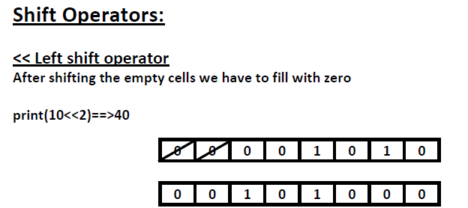
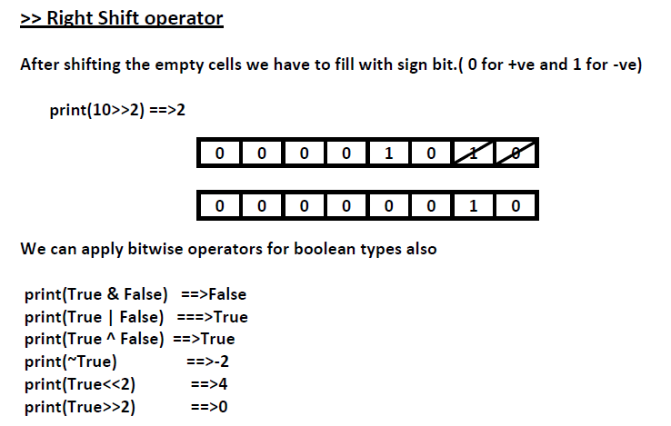

Slide 64
Assignment Operators:
We can use assignment operator to assign value to the variable.
Eg:
x=10
We can combine asignment operator with some other operator to form compound assignment operator.
Eg: x+=10 ====> x = x+10
The following is the list of all possible compound assignment operators in Python
+=
-=
*=
/=
%=
//=
**=
&=
|=
^=

Slide 65
Q. Program for minimum of 3 numbers
a=int(input("Enter First Number:"))
b=int(input("Enter Second Number:"))
c=int(input("Enter Third Number:"))
min=a if a<b and a<c else b if b<c else c
print("Minimum Value:",min)
Q. Program for maximum of 3 numbers
a=int(input("Enter First Number:"))
b=int(input("Enter Second Number:"))
c=int(input("Enter Third Number:"))
max=a if a>b and a>c else b if b>c else c
print("Maximum Value:",max)
Q. Program to check number
a=int(input("Enter First Number:"))
b=int(input("Enter Second Number:"))
print("Both numbers are equal" if a==b else "First Number is Less than Second Number" if a<b else "First Number Greater than Second Number")

Slide 66
Operator Precedence:
If multiple operators present then which operator will be evaluated first is decided by operator precedence.
Ex:
print(3+10*2) # 23
print((3+10)*2) # 26
The following list describes operator precedence in Python
1. () Parenthesis
2. ** exponential operator
3. ~,- Bitwise complement operator, unary minus operator
4. *,/,%,// multiplication, division, modulo,floor division
5. +,- addition, subtraction
6. <<,>> Left and Right Shift
7. & bitwise And

Slide 67
Input And Output Statements
In Python 3 we have only input() method and raw input() method is not available.
Python3 input() function behavior exactly same as raw input() method of Python2. i.e. every input value is treated as str type only.
raw input() function of Python 2 is renamed as input() function in Python3
Q. Write a program to read 2 numbers from the keyboard and print sum.
x=input("Enter First Number:")
y=input("Enter Second Number:")
i = int(x)
j = int(y)
print("The Sum:",i+j)
Output: ?

Slide 68
Q. Write a program to read Employee data from the keyboard and print that data.
eno=int(input("Enter Employee No:"))
ename=input("Enter Employee Name:")
esal=float(input("Enter Employee Salary:"))
eaddr=input("Enter Employee Address:")
married=bool(input("Employee Married ?[True|False]:"))
print("Please Confirm Information")
print("Employee No :",eno)
print("Employee Name :",ename)
print("Employee Salary :",esal)
print("Employee Address :",eaddr)
print("Employee Married ? :",married)
Output: ?

Slide 69
Q. How to read multiple values from the keyboard in a single line:
a,b= [int(x) for x in input("Enter 2 numbers :").split()]
print("Product is :", a*b)
Output:
Enter 2 numbers :10 20
Product is : 200
Note: split() function can take space as separator by default .But we can pass anything as separator.

Slide 70
output statements:
We can use print() function to display output.
1: print() without any argument
Just it prints new line character
2:
print(String):
print("Hello World")
#We can use escape characters also
print("Hello \n World")
print("Hello\tWorld")
#We can use repete tion operator (*) in the string
print(10*"Hello")
print("Hello"*10)
#We can use + operator also
print("Hello"+"World")

Slide 71
3. print() with variable number of arguments:
a,b,c=10,20,30
print("The Values are :",a,b,c)
Output: The Values are : 10 20 30
* By default output values are seperated by space.If we want we can specify seperator by using "sep" attribute
a,b,c=10,20,30
print(a,b,c,sep=',')
print(a,b,c,sep=':')
O/P: 10,20,30
10:20:30
4:print() with end attribute:
print("Hello")
print(“Mister")
print(“Abhi")
Output:
Hello
Mister
Abhi

Slide 72
If we want output in the same line with space
print("Hello",end=' ')
print(“Mister",end=' ')
print(“Abhi")
Output: Hello Mister Abhi
Note: The default value for end attribute is \n, which is nothing but new line character.
5: print(object) statement:
We can pass any object (like list,tuple,set etc)as argument to the print() statement.
Ex: l=[10,20,30,40]
t=(10,20,30,40)
print(l)
print(t)

Slide 73
6: print(String,variable list):
We can use print() statement with String and any number of arguments.
Ex:
s=“Abhi“
a=28
s1="java“
s2="Python“
print("Hello",s,"Your Age is",a)
print("You are teaching",s1,"and",s2)
Output:
Hello Abhi Your Age is 28
You are teaching java and Python

Slide 74
7: print(formatted string):
%i====>int
%d====>int
%f=====>float
%s======>String type
Syntax:
print("formatted string" %(variable list))
Ex 1:
a=10
b=20
c=30
print("a value is %i" %a)
print("b value is %d and c value is %d" %(b,c))
Output: a value is 10
b value is 20 and c value is 30
Ex 2:
s=“Abhi“
list=[10,20,30,40]
print("Hello %s ...The List of Items are %s" %(s,list))
Output: Hello Abhi ...The List of Items are [10, 20, 30, 40]

Slide 75
8: print() with replacement operator {}
Ex: name=“Abhi”
salary=10000
frnd=“Amit"
print("Hello {0} your salary is {1} and Your Friend {2} is waiting".format(name,salary,frnd))
print("Hello {x} your salary is {y} and Your Friend {z} is waiting".format(x=name,y=salary,z=frnd))
Output:
Hello Abhi your salary is 10000 and Your Friend Amit is waiting
Hello Abhi your salary is 10000 and Your Friend Amit is waiting

